Slide 1
SuperStore Data Analysis Using Ai with Data Science
SuperStore Data Analysis Using Data Analytics and Data Science
Presented By
Student Name: S.SHRRIVATHSAN
College Name: Panimalar ENGINEERING COLLEGE
Department: COMPUTER SCIENCE DEPARTMENT
Email ID: shrrivathsany2k@gmail.com
AICTE Student ID: STU680f6b03bd1fe1745840899
Internship ID: INTERNSHIP_1748937226683eaa0a58abc

Slide 2
OUTLINE
Problem Statement (Should not include solution)
Proposed System/Solution
System Development Approach (Technology Used)
Algorithm & Deployment
Result (Output Image)
Conclusion
Future Scope
References

Slide 3
Problem Statement
Problem Statement:
The objective is to analyze the historical sales and profit data of a superstore to identify key trends, patterns, and anomalies, and subsequently leverage these insights to optimize business operations, enhance customer satisfaction, and maximize profitability. This involves using data science techniques, including descriptive analytics, predictive modeling, and potentially prescriptive analytics, to address specific business questions and inform strategic decision-making.
Key objectives
Identify key drivers of sales and profitability: Understanding which factors contribute most significantly to sales and profit across different products, regions, and customer segments.
Forecast future sales and demand: Accurately predict sales and demand for various products to optimize inventory levels and prevent stockouts or overstocking, which can reduce waste and save costs.
Segment customers and personalize recommendations: Identify distinct customer segments based on their preferences and buying behavior to tailor marketing campaigns and product recommendations, enhancing customer satisfaction and loyalty.
Identify underperforming products and categories: Pinpoint products or categories experiencing low sales or profitability to develop strategies for improvement, such as adjusting pricing, promotional activities, or exploring alternative sourcing.
Improve shipping and logistics efficiency: Analyze shipping mode performance and optimize logistics to reduce costs and delivery times, ultimately improving customer satisfaction and retention.

Slide 4
Data science approach and AI techniques
The project will involve the following steps and techniques:
Data Collection and Cleaning:
Gather historical sales data, including product information, customer details, order history, and shipping information.
Clean and preprocess the data to handle missing values, inconsistencies, and outliers, ensuring data quality for analysis and model building.
Exploratory Data Analysis (EDA):
Conduct EDA to understand the data structure, distributions, and initial trends in sales, profit, and other key metrics across various dimensions (categories, regions, segments, etc.).
Utilize visualizations like bar charts, scatter plots, and geographical maps to uncover patterns, disparities, and anomalies in the sales data.
Feature Engineering:
Create new features from existing data, such as seasonality indicators, discount ratios, or customer lifetime value metrics, to enhance the predictive power of models.

Slide 5
Model Building and Training:
Sales Forecasting: Employ AI and machine learning models like time series forecasting (e.g., ARIMA or Prophet) to predict future sales based on historical data and seasonal patterns.
Customer Segmentation: Apply unsupervised learning algorithms (e.g., K-Means clustering) to segment customers based on purchase history, demographics, and behavior.
Product Recommendation: Build personalized recommendation systems using collaborative filtering or content-based filtering techniques to suggest products to customers based on their preferences and browsing history.
Profitability Analysis: Utilize regression models or machine learning algorithms to identify factors influencing profitability and predict potential losses or areas of improvement.
Model Evaluation:
Evaluate the performance of the developed models using appropriate metrics, such as Mean Absolute Percentage Error (MAPE) for forecasting or accuracy/precision/recall for classification tasks.
Deployment and Monitoring:
Deploy the models into a production environment for continuous analysis and prediction.
Establish a monitoring system to track model performance and ensure the generated insights remain accurate and relevant over time.

Slide 6
Proposed Solution
The proposed system aims to address the challenge of predicting the required bike count at each hour to ensure a stable supply of rental bikes. This involves leveraging data analytics and machine learning techniques to forecast demand patterns accurately. The solution will consist of the following components:
Data Collection:
Gather historical data on bike rentals, including time, date, location, and other relevant factors.
Utilize real-time data sources, such as weather conditions, events, and holidays, to enhance prediction accuracy.
Data Preprocessing:
Clean and preprocess the collected data to handle missing values, outliers, and inconsistencies.
Feature engineering to extract relevant features from the data that might impact bike demand.
Machine Learning Algorithm:
Implement a machine learning algorithm, such as a time-series forecasting model (e.g., ARIMA, SARIMA, LSTM, XGBOOST), to predict bike counts based on historical patterns.
Consider incorporating other factors like weather conditions, day of the week, and special events to improve prediction accuracy.
Deployment:
Develop a user-friendly interface or application that provides real-time predictions for bike counts at different hours.
Deploy the solution on a scalable and reliable platform, considering factors like server infrastructure, response time, and user accessibility.
Evaluation:
Assess the model's performance using appropriate metrics such as Mean Absolute Error (MAE), Root Mean Squared Error (RMSE), or other relevant metrics.
Fine-tune the model based on feedback and continuous monitoring of prediction accuracy.

Slide 7
System Approach
The "System Approach" section outlines the overall strategy and methodology for developing and implementing the rental bike prediction system. Here's a suggested structure for this section:
System requirement's
Library required to build the model

Slide 8
SYSTEM REQUIREMENTS
1. Hardware Requirements:
Processor: Intel i5/i7 or equivalent (multi-core recommended)
RAM: Minimum 8 GB (16 GB recommended for faster processing)
Storage: Minimum 1 GB free space (for dataset and libraries)
2. Software Requirements:
OS: Windows 10/11, macOS, or any Linux distribution
Python version: 3.8 or above
IDE: Jupyter Notebook, VS Code, or Google Colab

Slide 9
Library required to build the model
1. Data Handling & Manipulation
pandas – For reading and manipulating tabular data
numpy – For numerical operations
2. Data Visualization
matplotlib – For basic plotting and visualization
seaborn – For advanced statistical plots
3. Data Preprocessing
sklearn.preprocessing – For encoding, scaling, imputing data
4. Model Building
sklearn.linear_model – For linear regression models
sklearn.ensemble – For models like Random Forest, Gradient Boosting
xgboost – For extreme gradient boosting (if needed)
lightgbm – For faster and efficient boosting (optional)

Slide 10
Library required to build the model
5. Model Evaluation
sklearn.metrics – For performance evaluation metrics like RMSE, R², MAE
6. Optional (Advanced Visualization & Tuning)
plotly – For interactive charts
scipy – For statistical operations
sklearn.model_selection – For cross-validation and hyperparameter tuning

Slide 11
Algorithm & Deployment
1. Project Objective
Analyze the Superstore dataset to:
Understand sales performance
Identify top-performing segments, products, and regions
Predict future sales
Detect anomalies (e.g., loss-generating items)
Provide decision support via a deployed web application
2. Data Science Workflow`
A. Exploratory Data Analysis (EDA)
Visualize sales, profit by region, category, and customer segment
Heatmaps for correlation
Time series of sales over time
Identify loss-making sub-categories
B. Feature Engineering
Extract year, month from Order Date
Compute Profit Margin
Aggregate metrics by customer/product/region
C. Machine Learning Algorithms
Choose ML algorithms based on your goals:
1. Sales Prediction
Algorithms: Linear Regression, Random Forest, XGBoost
Input: Product, Region, Time, Discount, Quantity
Output: Expected Sales/Profit

Slide 12
Algorithm & Deployment
2. Customer Segmentation
Algorithm: K-Means Clustering
Features: Total Sales, Orders, Average Profit
Outcome: Targeted marketing
3. Anomaly Detection
Algorithms: Isolation Forest, DBSCAN
Detect: Unusual profit margins, high discounts
4. Product Recommendation
Algorithm: Association Rules (Apriori), Collaborative Filtering
4. AI Integration (Optional)
Use LSTM (Deep Learning) for time-series sales forecasting
Integrate NLP to generate insights like: “Top 5 loss-making products in the West region in 2024”.
5. Tools and Libraries
Python Libraries
pandas, numpy, matplotlib, seaborn – for EDA
scikit-learn – ML algorithms
xgboost, lightgbm – advanced models
statsmodels or fbprophet – time series forecasting
flask or streamlit – for web deployment

Slide 13
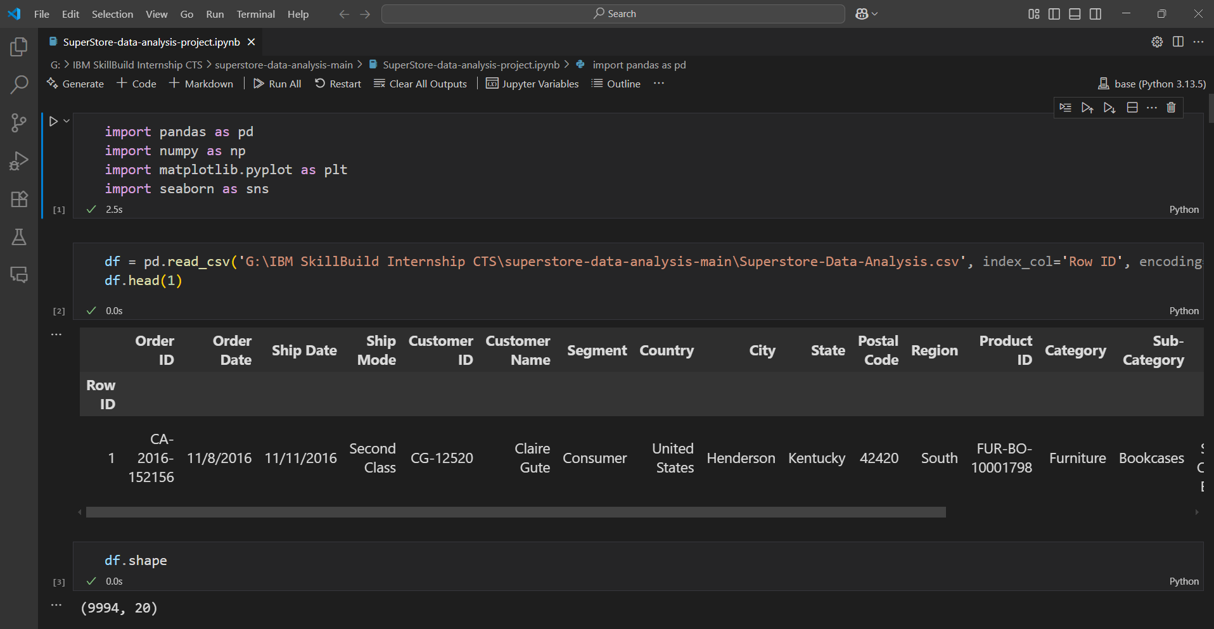
Results and screenshots

Slide 14
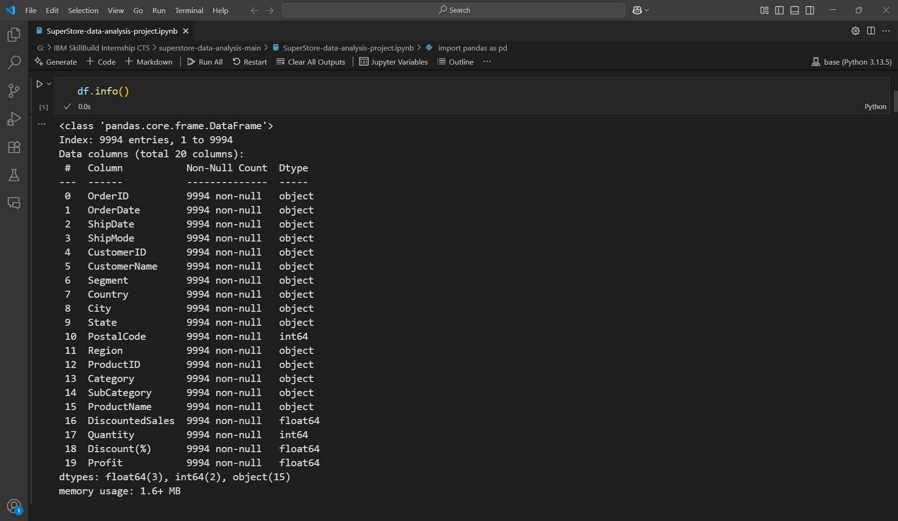
Results and screenshots

Slide 15
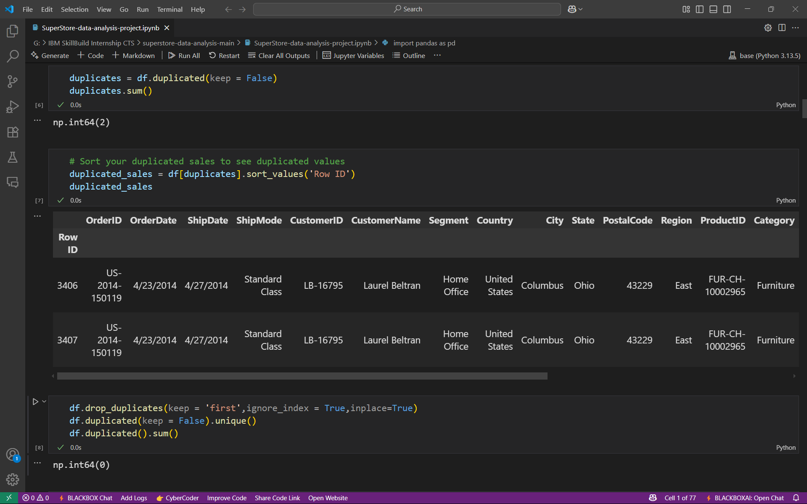
Results and screenshots

Slide 16
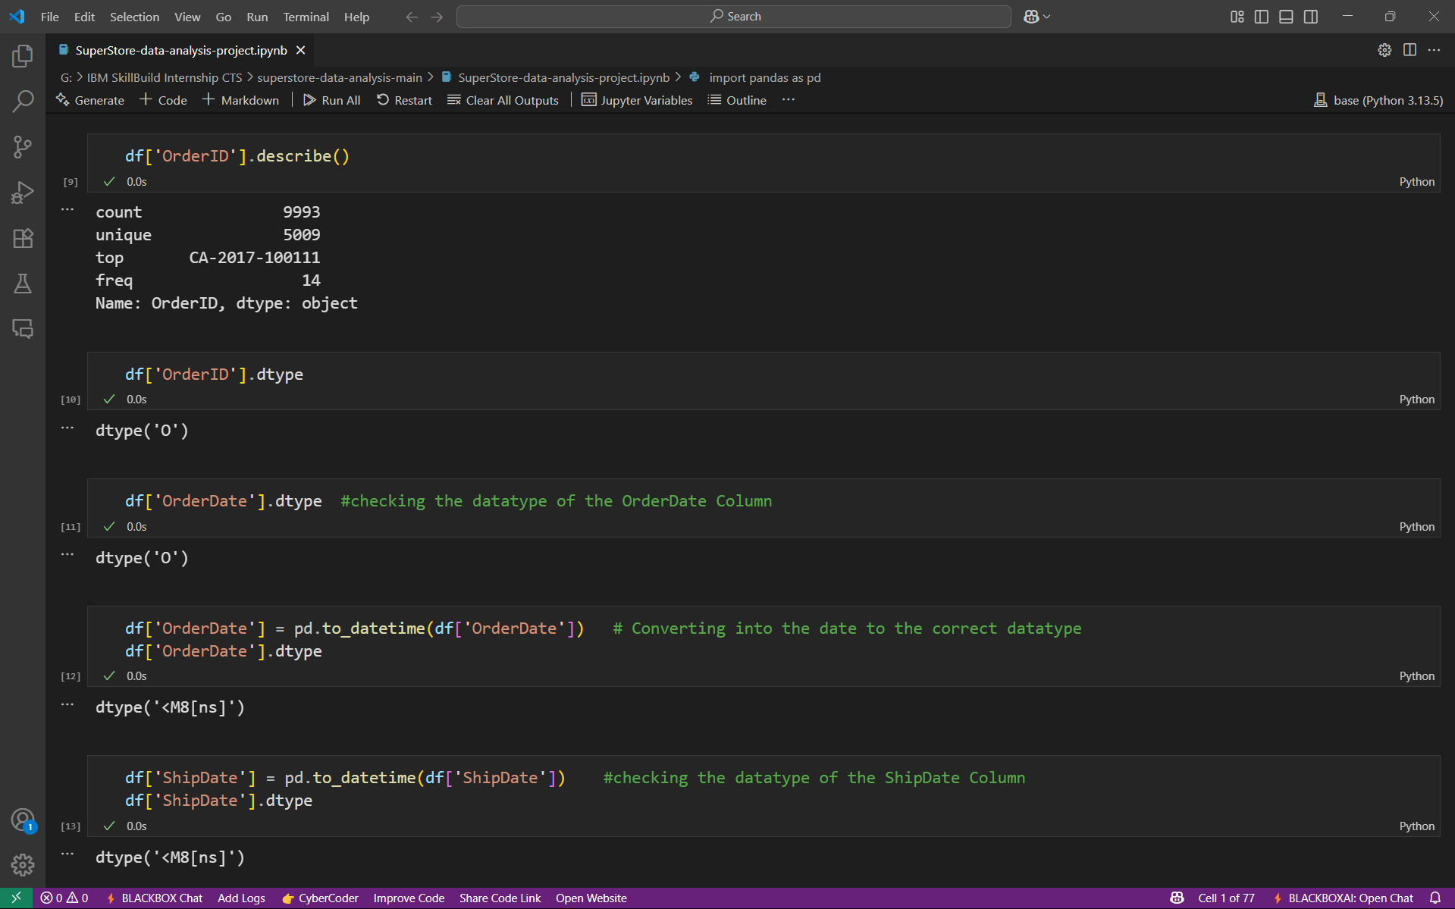
Results and screenshots

Slide 17
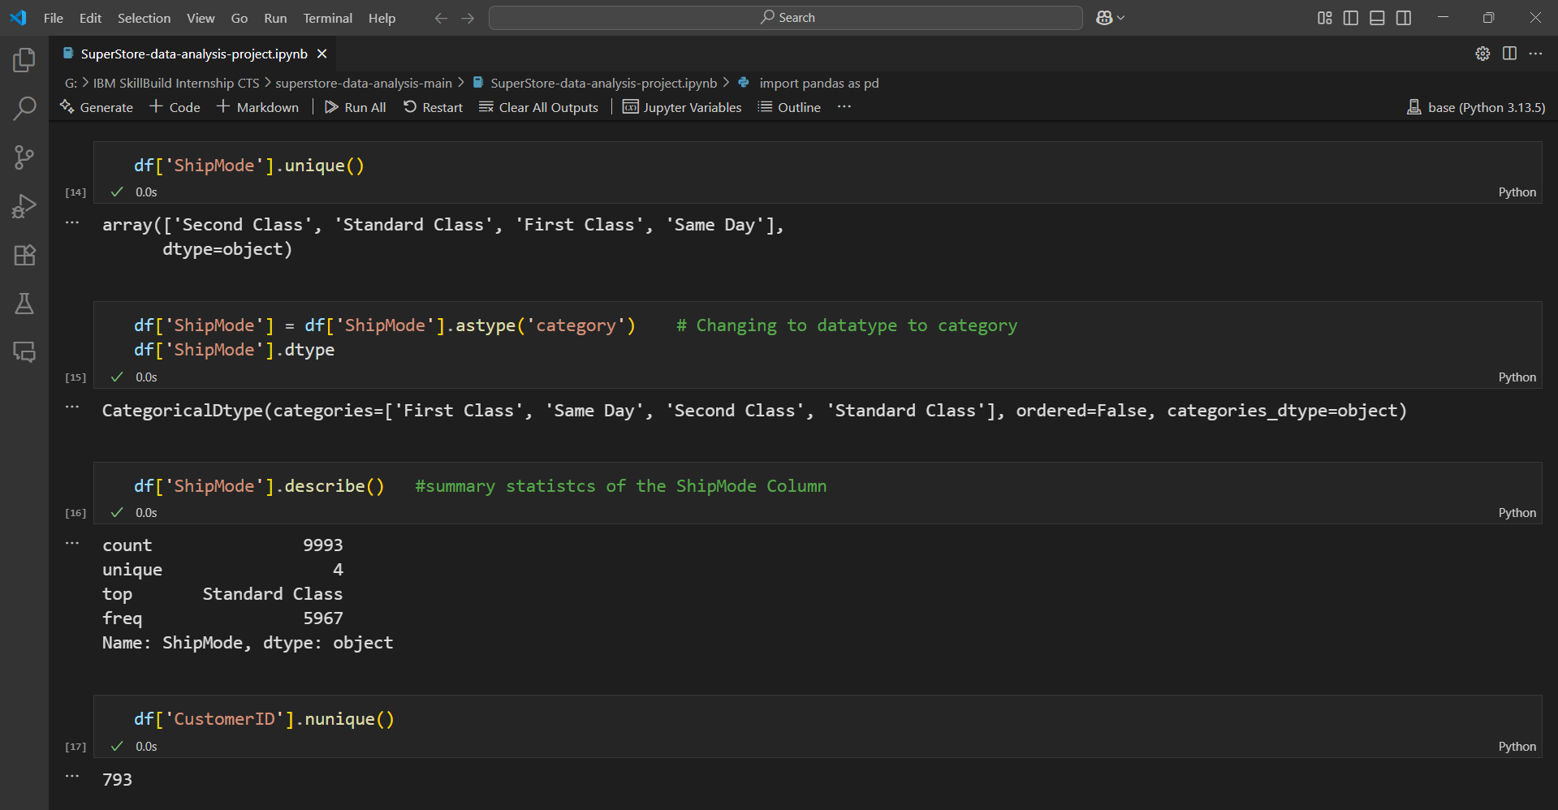
Results and screenshots

Slide 18
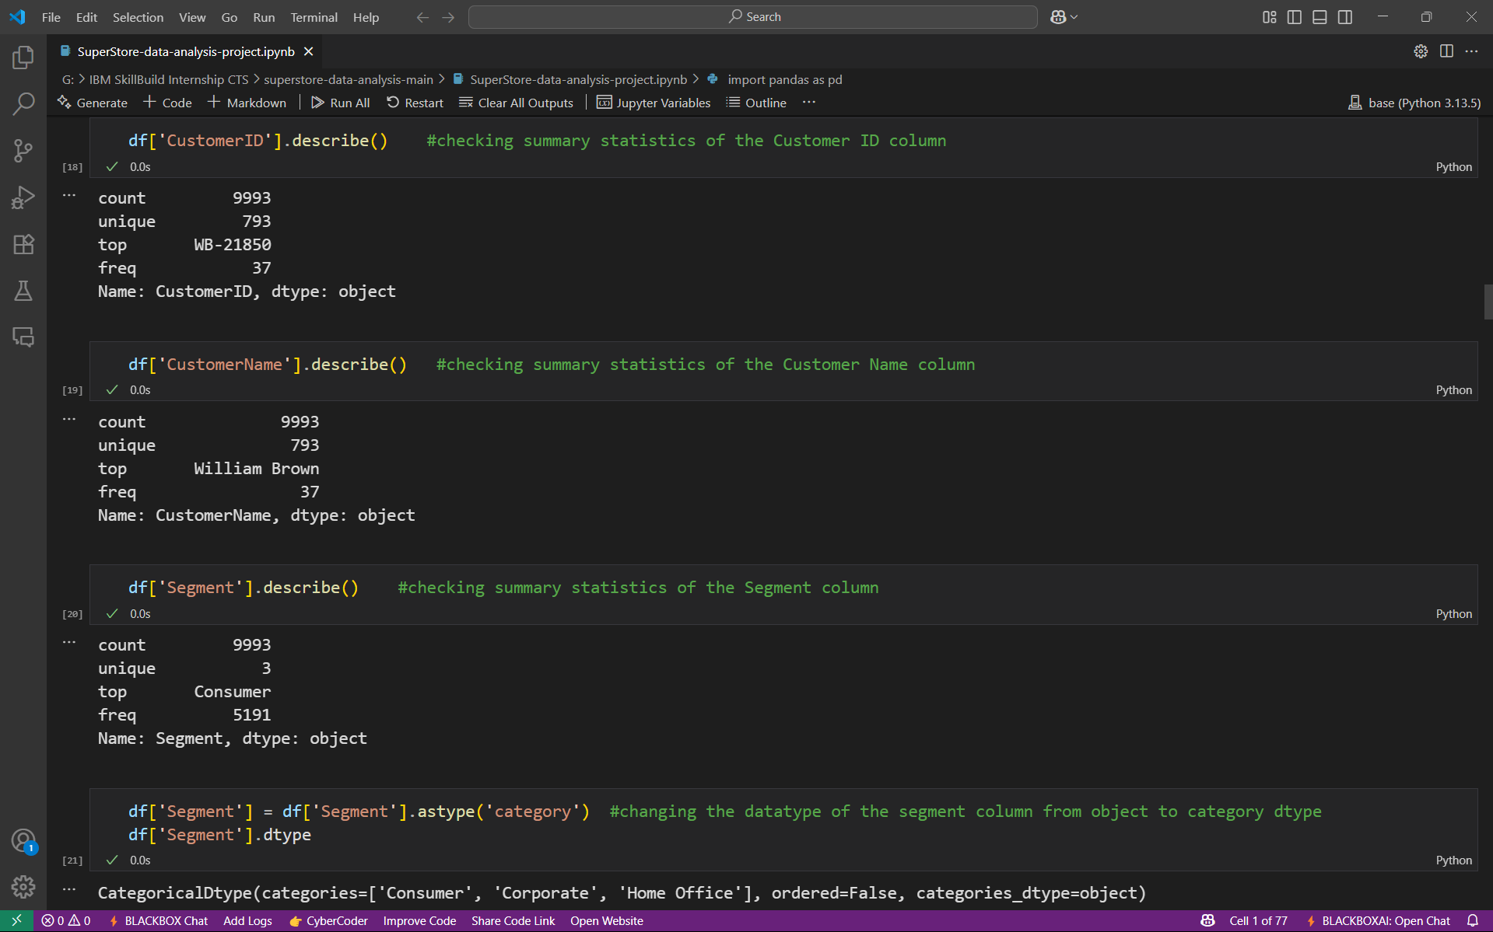
Results and screenshots

Slide 19
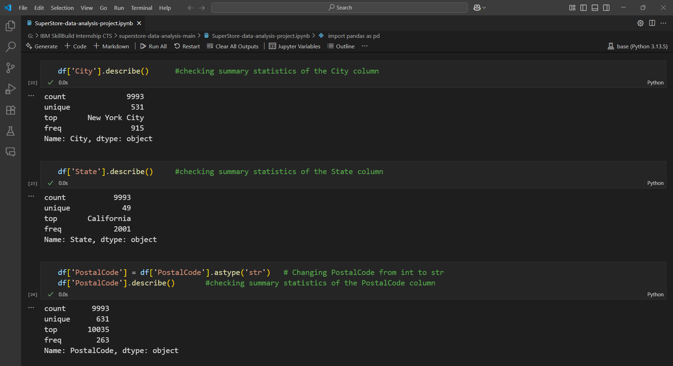
Results and screenshots

Slide 20
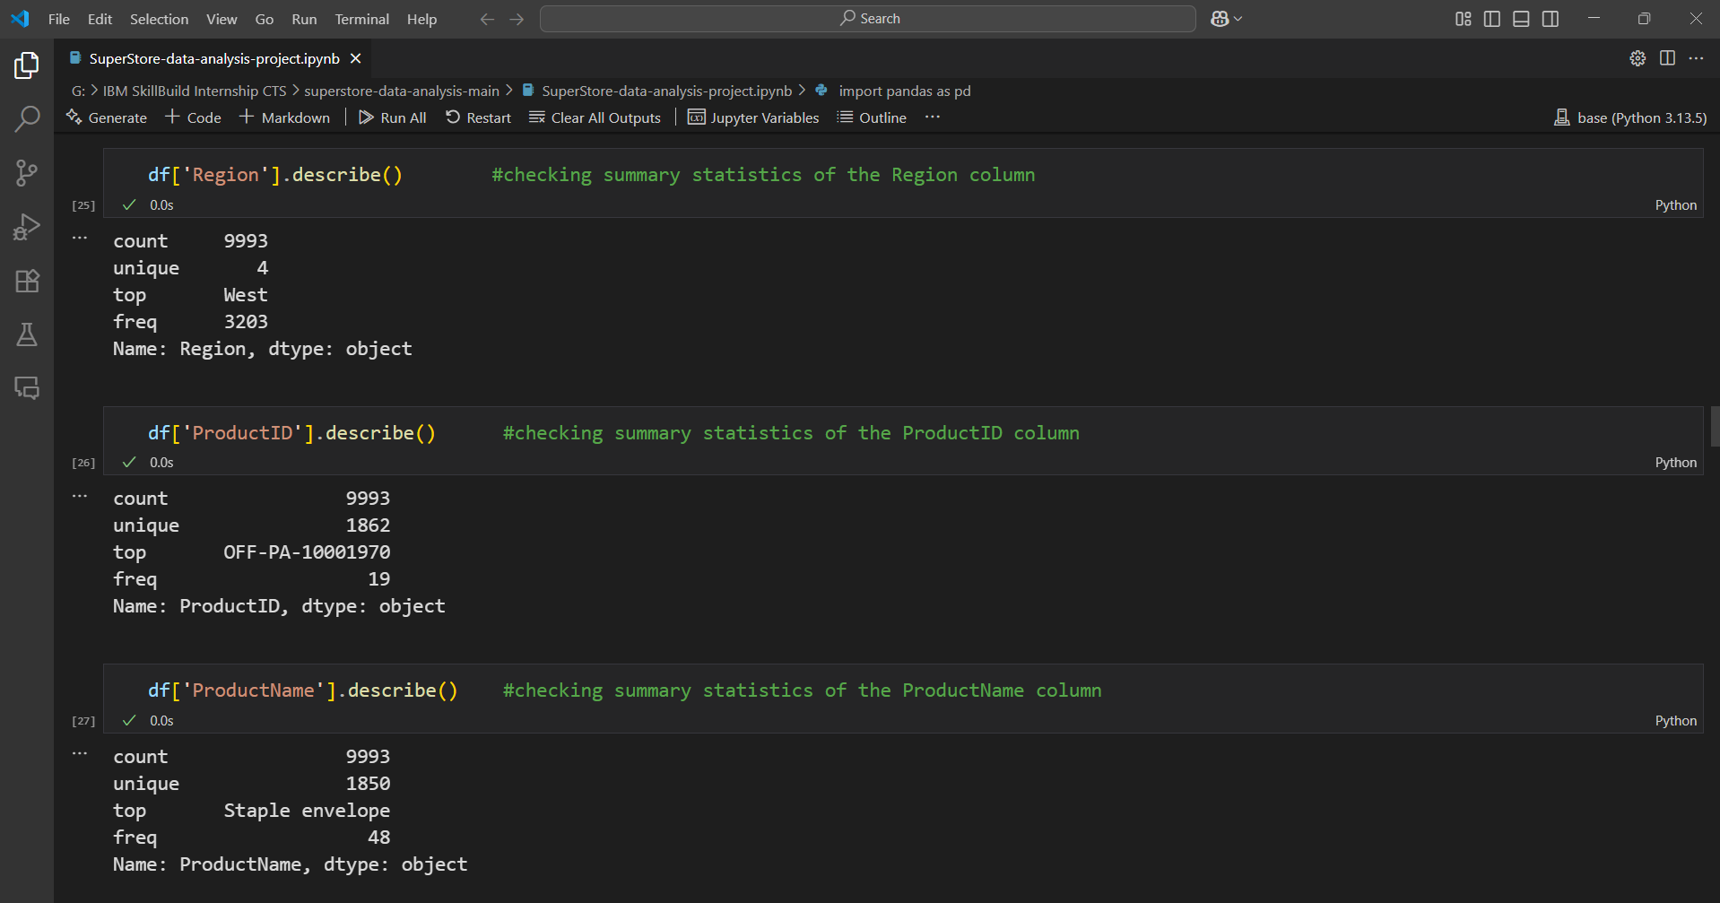
Results and screenshots

Slide 21
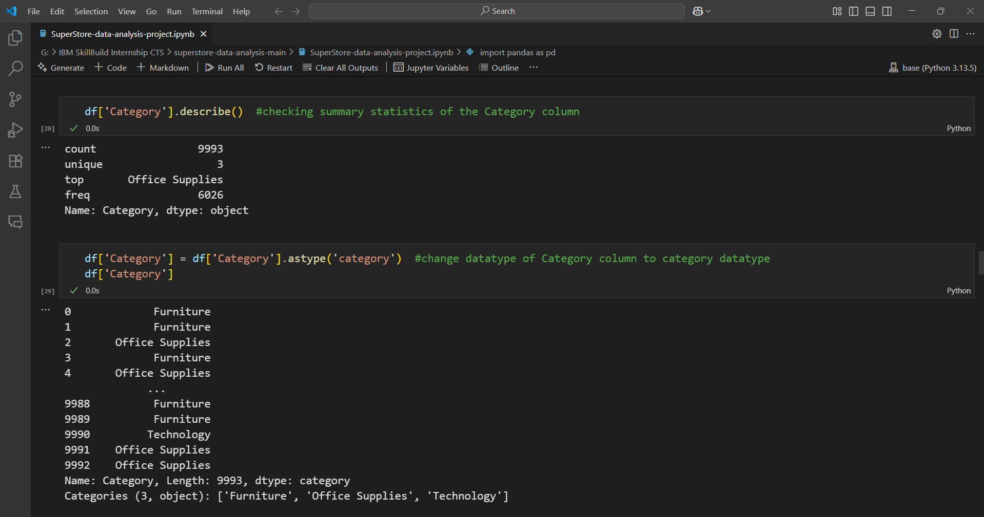
Results and screenshots

Slide 22
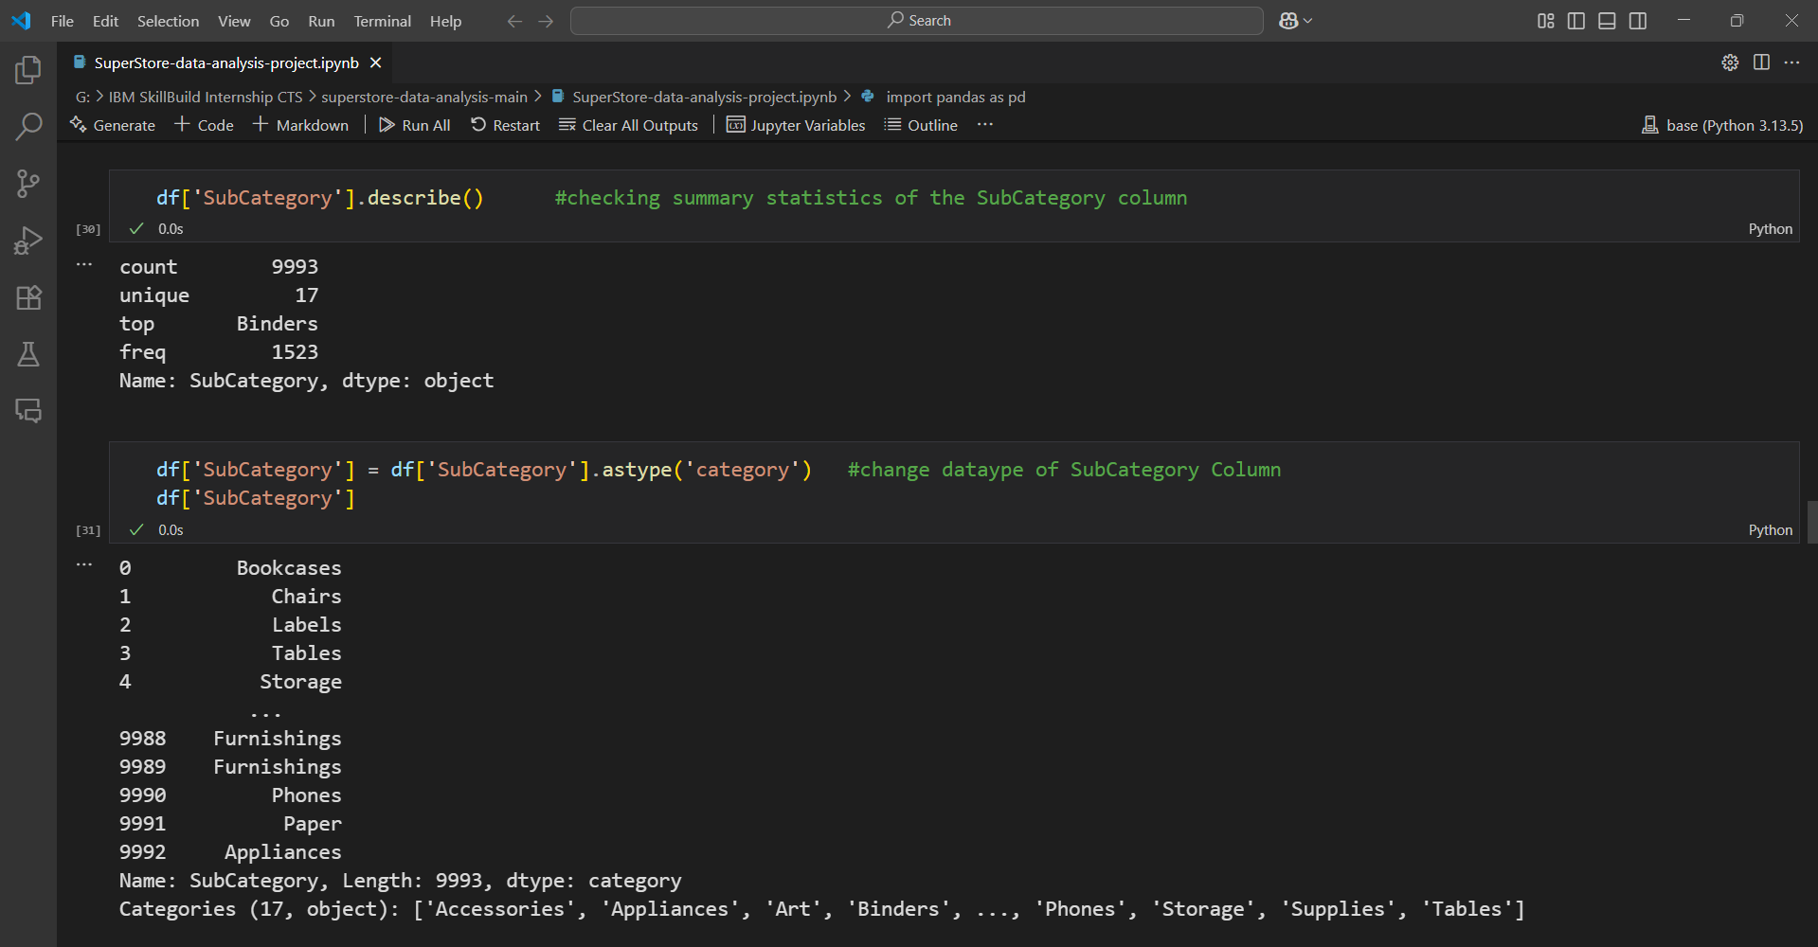
Results and screenshots

Slide 23
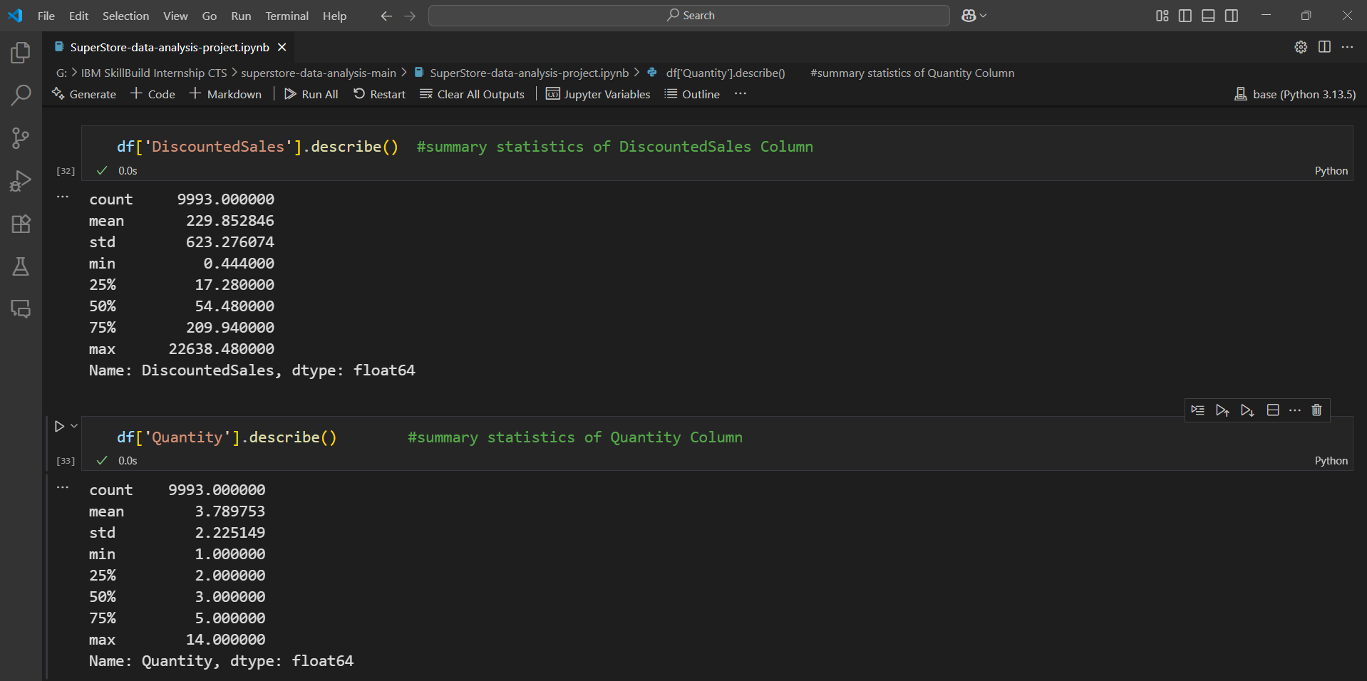
Results and screenshots

Slide 24
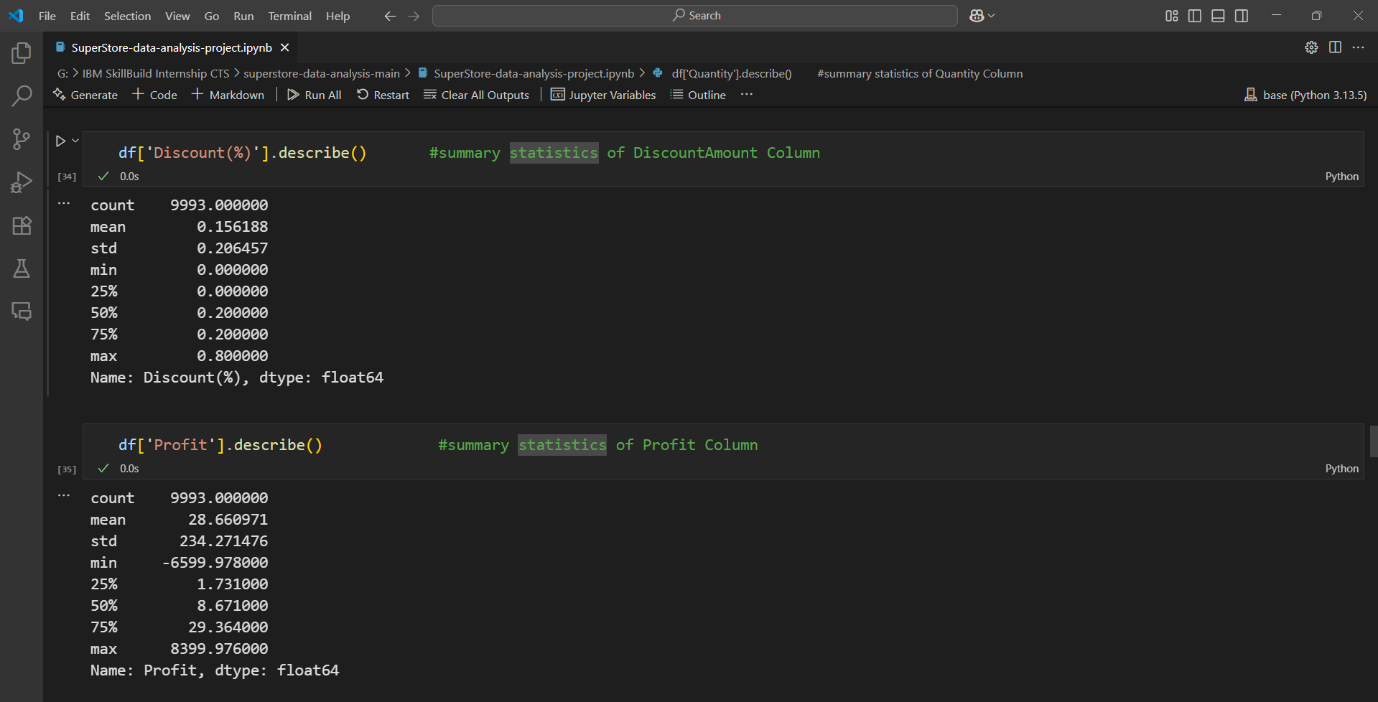
Results and screenshots

Slide 25
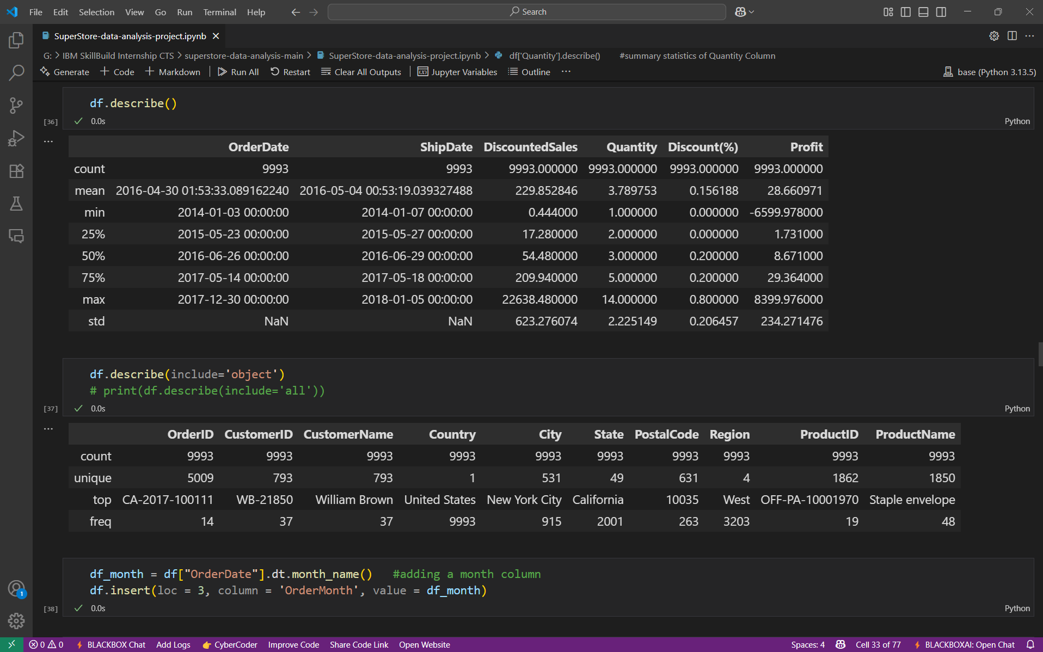
Results and screenshots

Slide 26
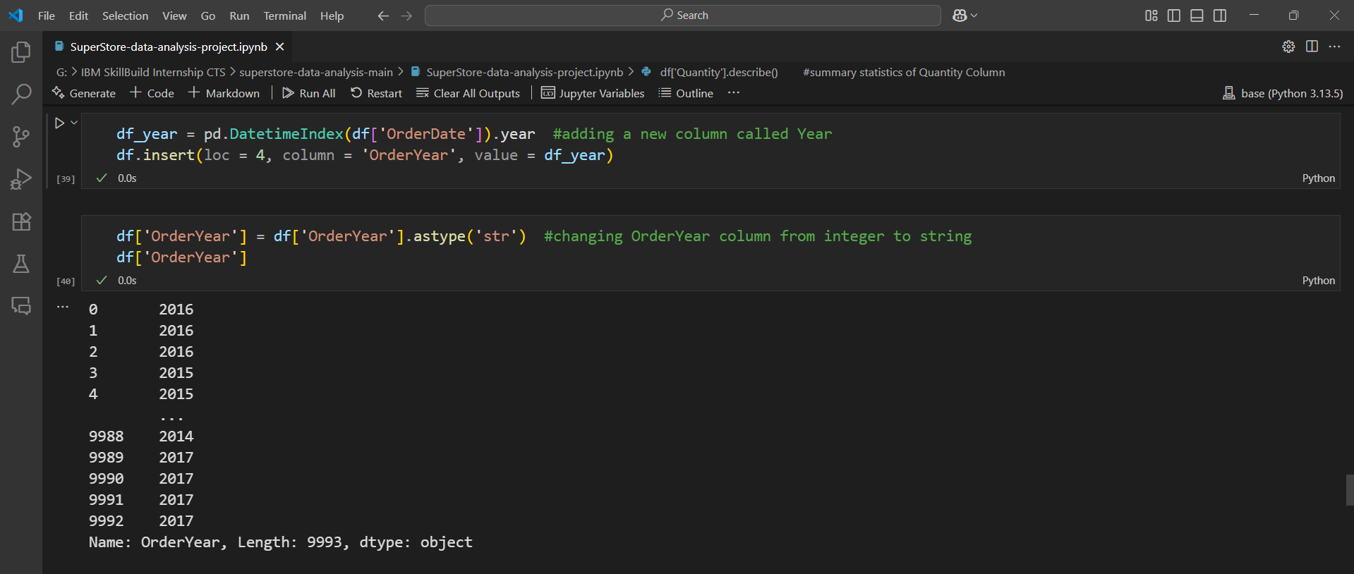
Results and screenshots

Slide 27
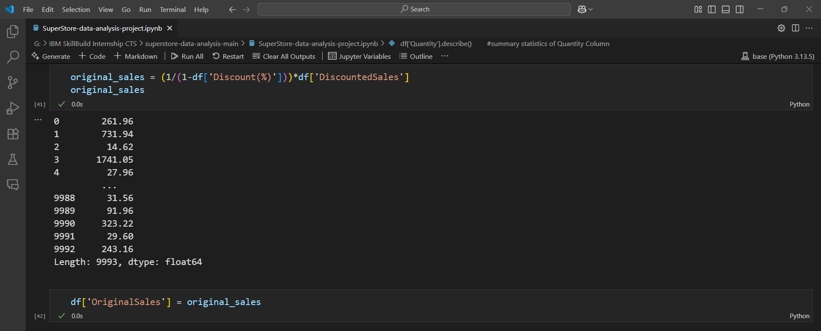
Results and screenshots

Slide 28
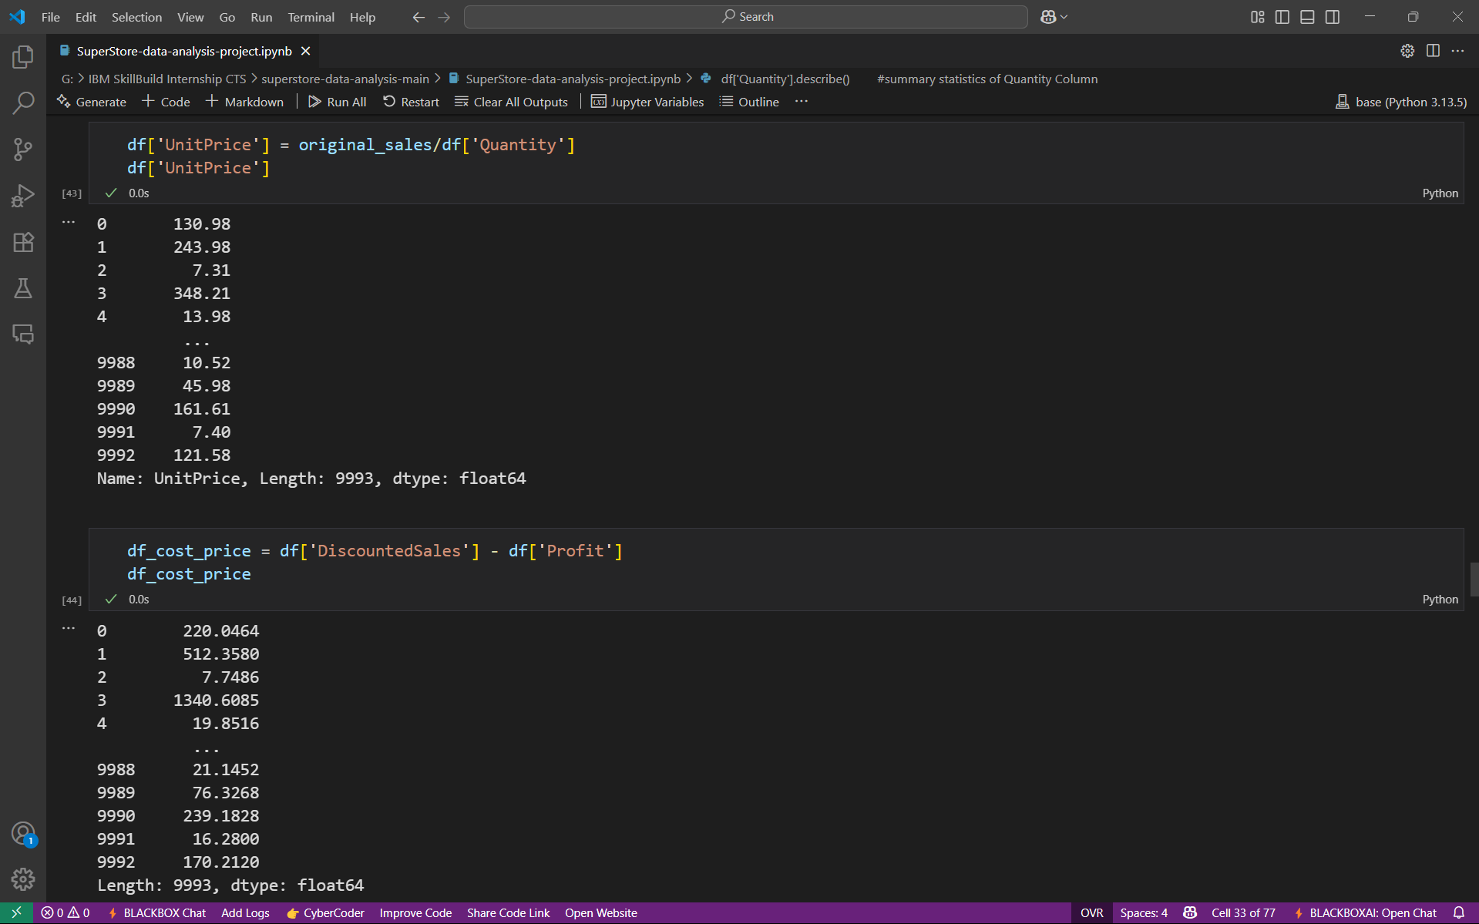
Results and screenshots

Slide 29
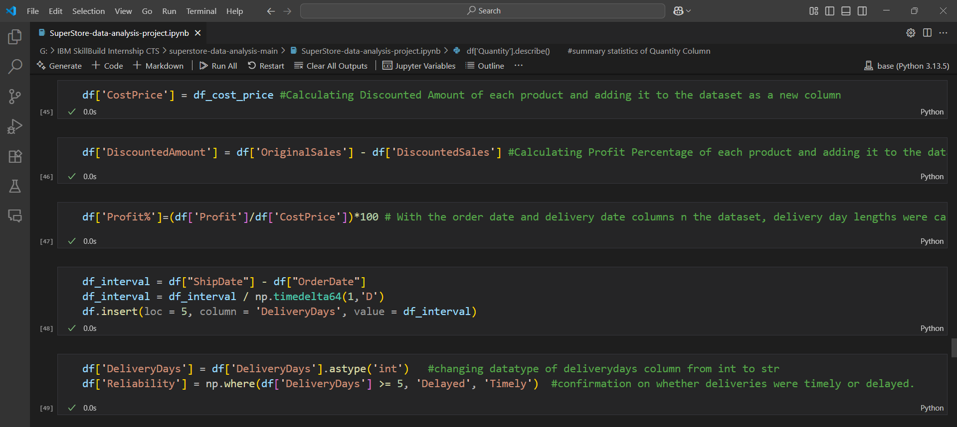
Results and screenshots

Slide 30
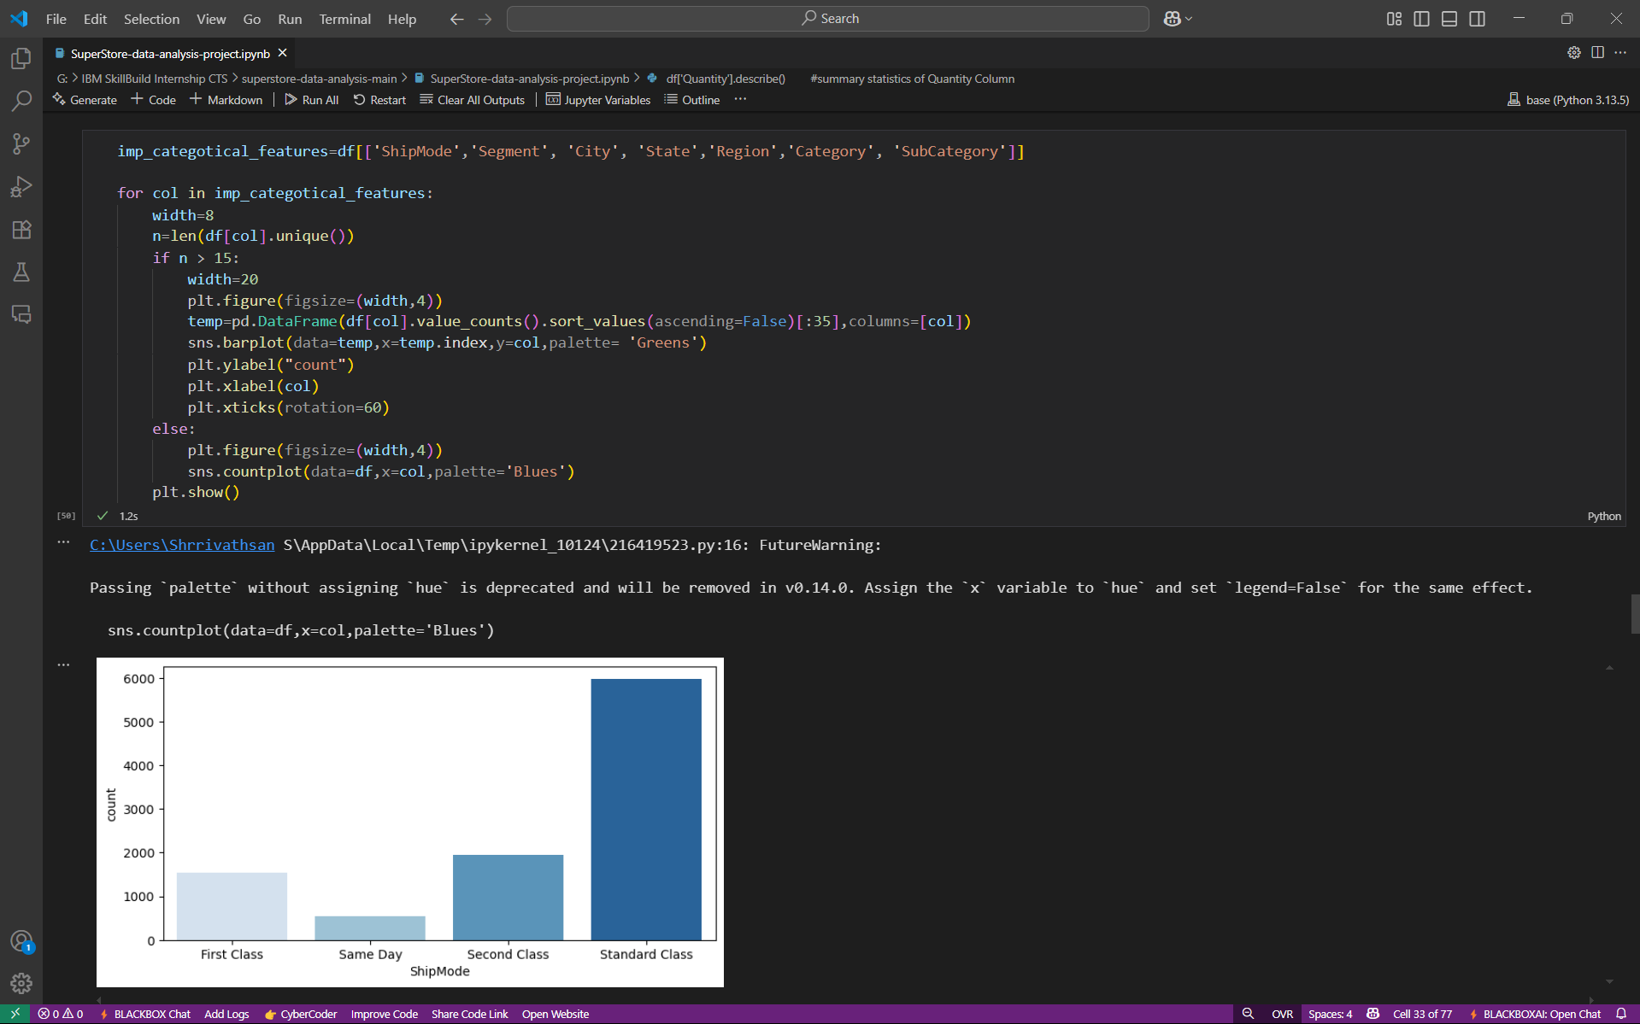
Results and screenshots

Slide 31
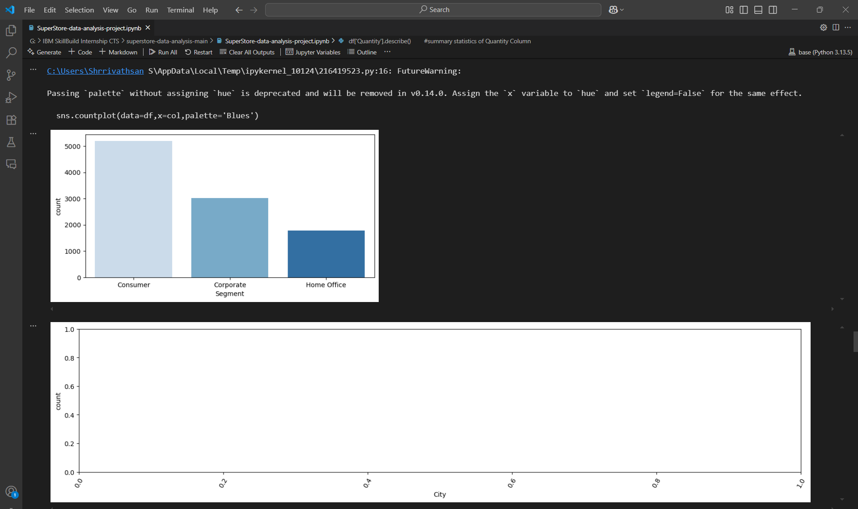
Results and screenshots

Slide 32
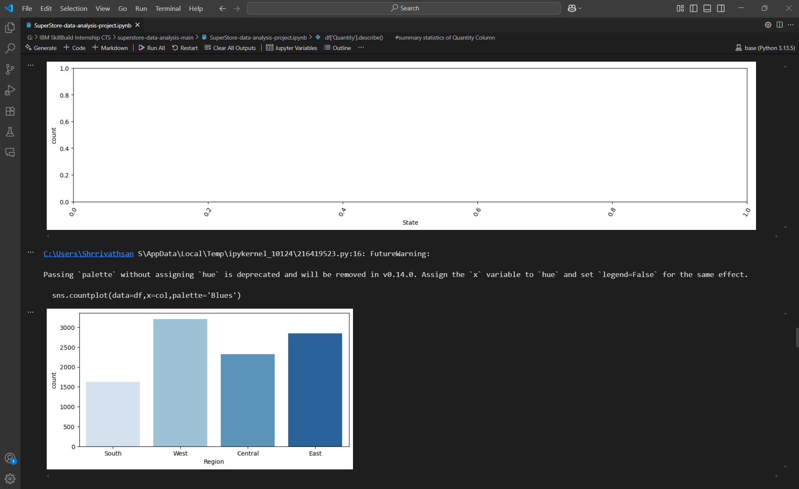
Results and screenshots

Slide 33
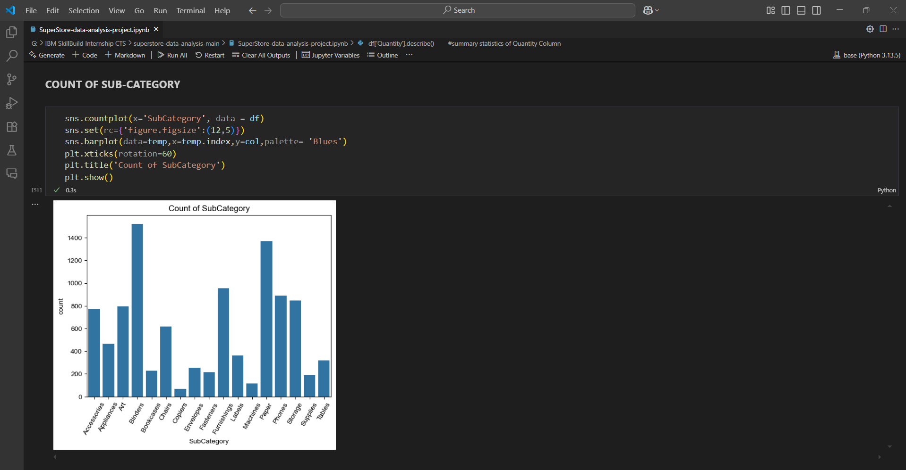
Results and screenshots

Slide 34
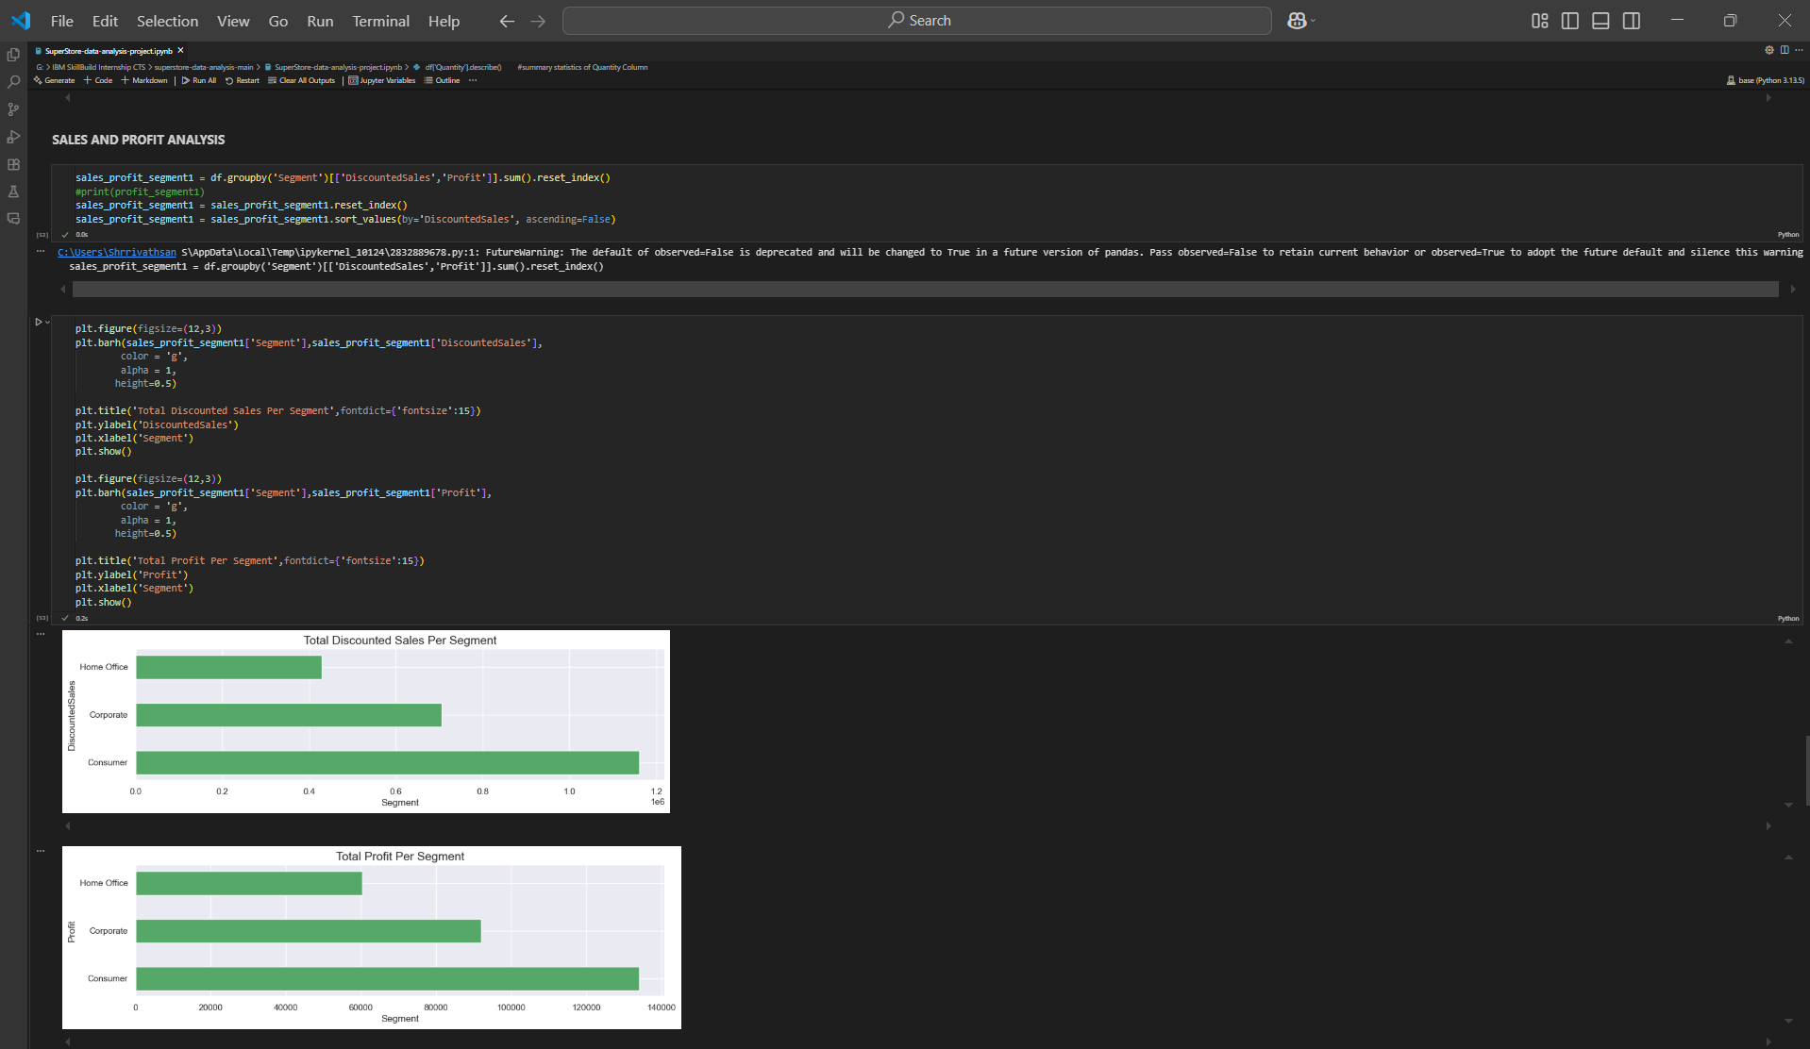
Results and screenshots

Slide 35
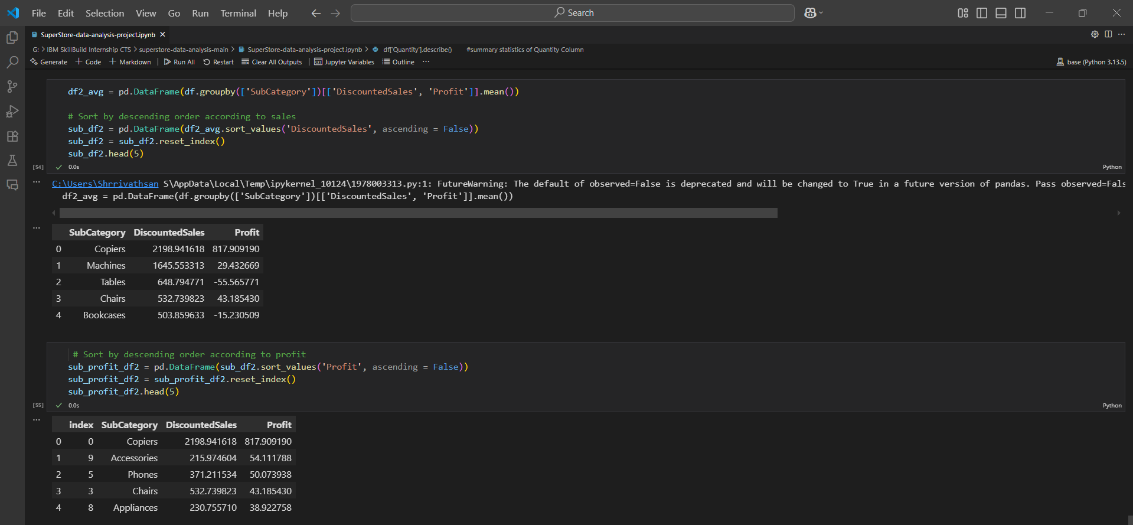
Results and screenshots

Slide 36
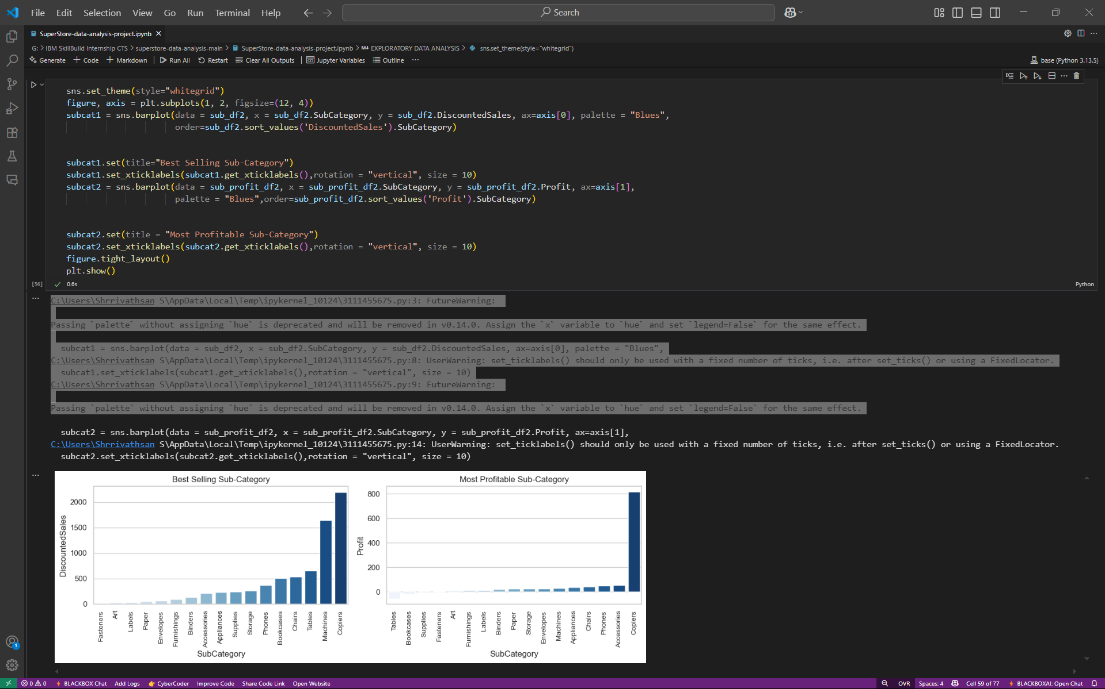
Results and screenshots

Slide 37
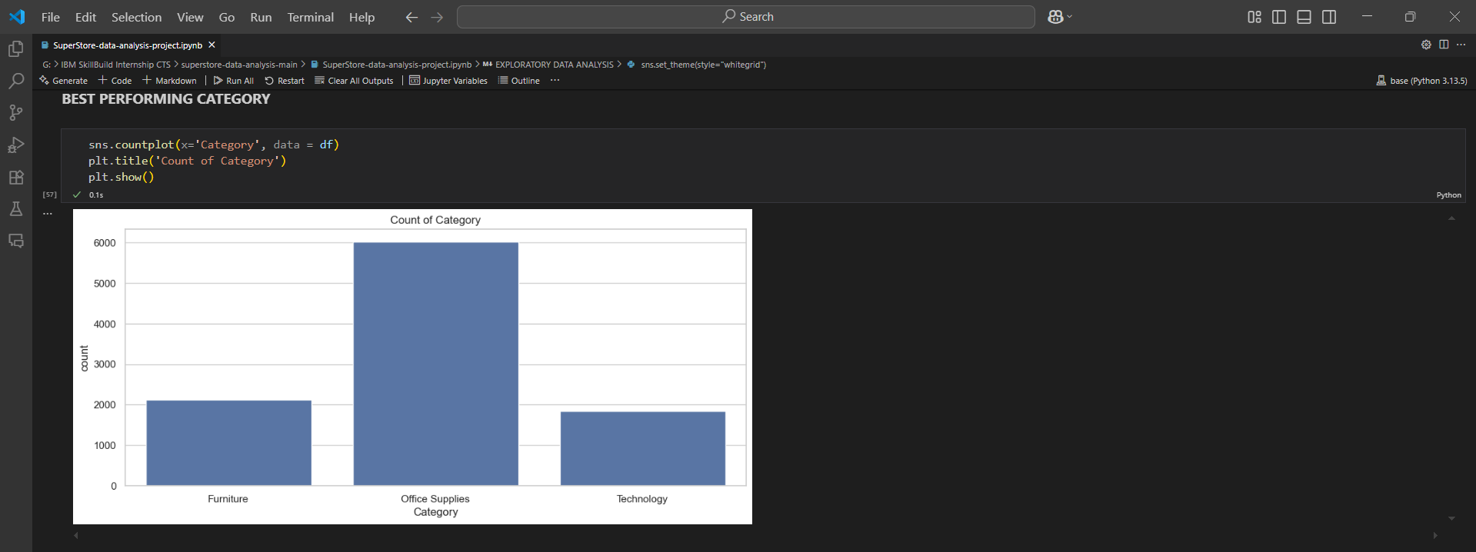
Results and screenshots

Slide 38
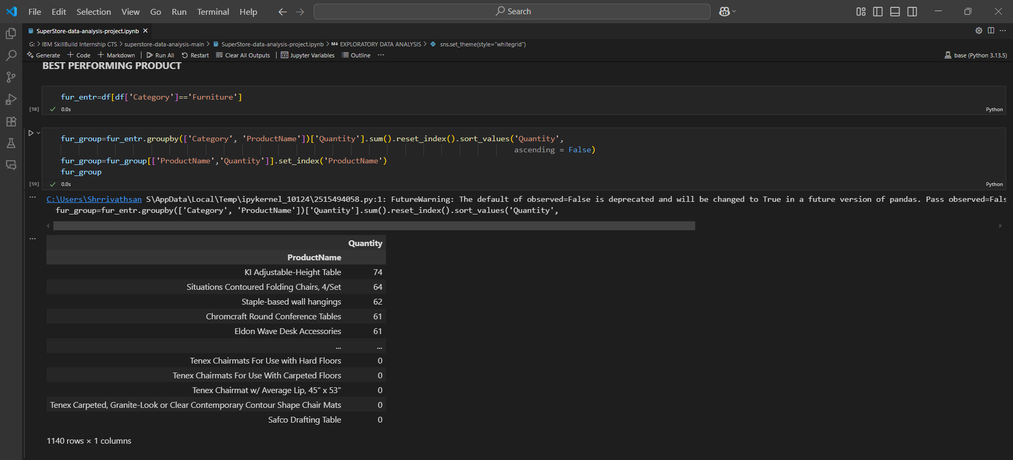
Results and screenshots

Slide 39
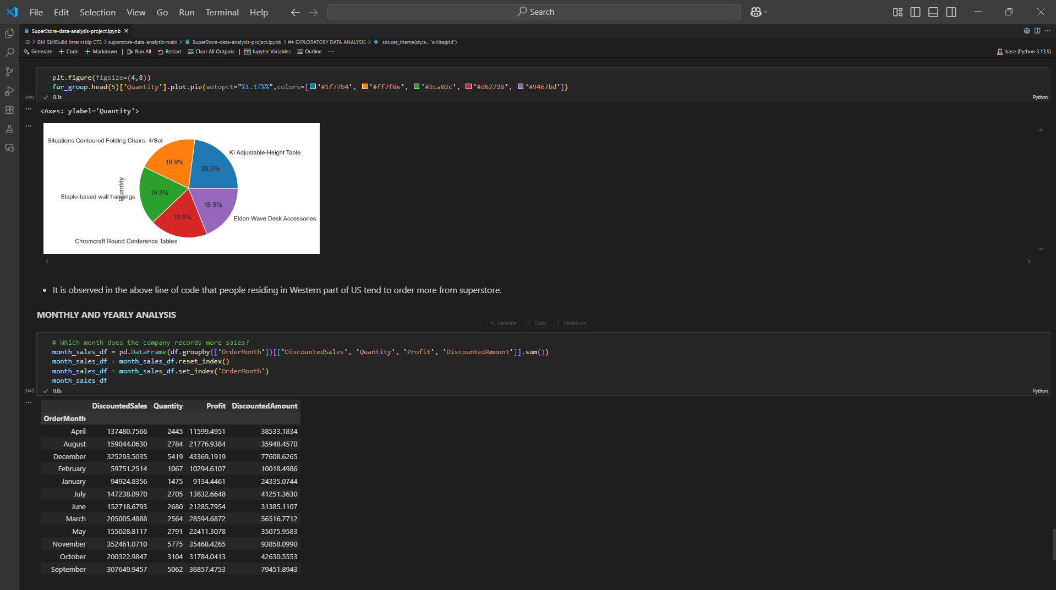
Results and screenshots

Slide 40
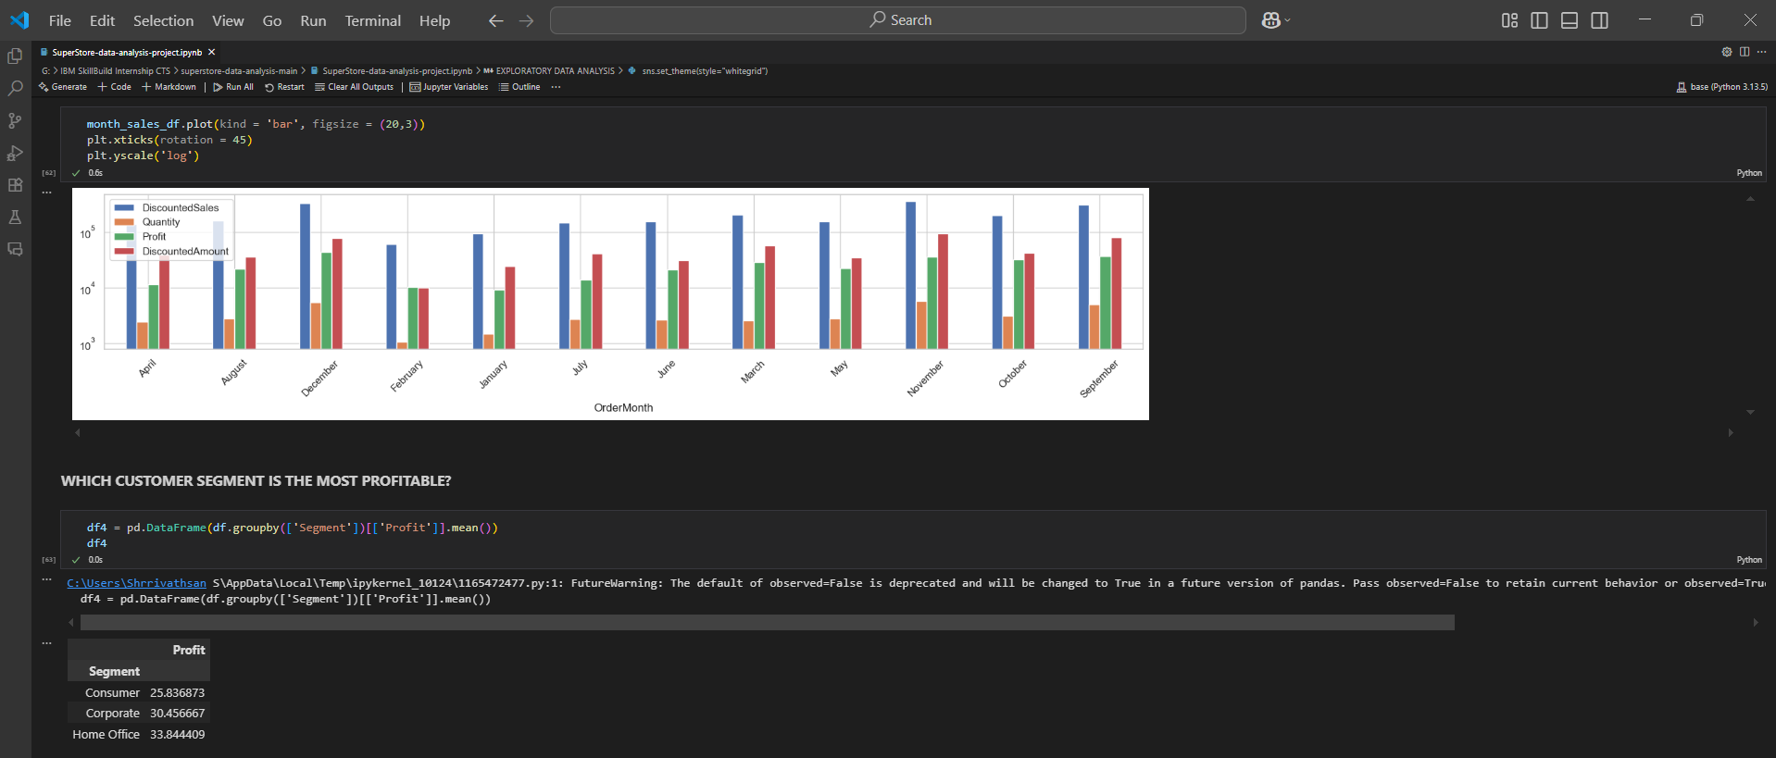
Results and screenshots

Slide 41
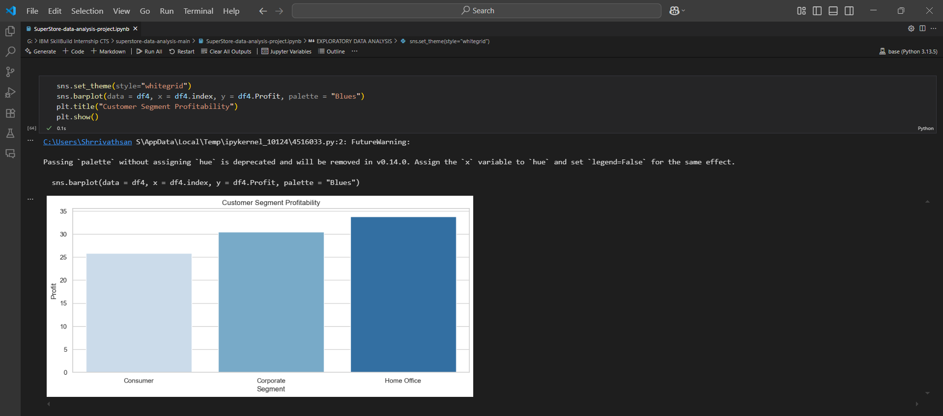
Results and screenshots

Slide 42
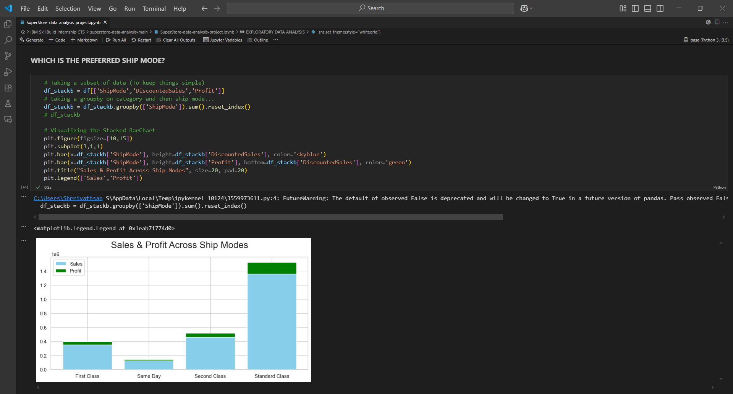
Results and screenshots

Slide 43
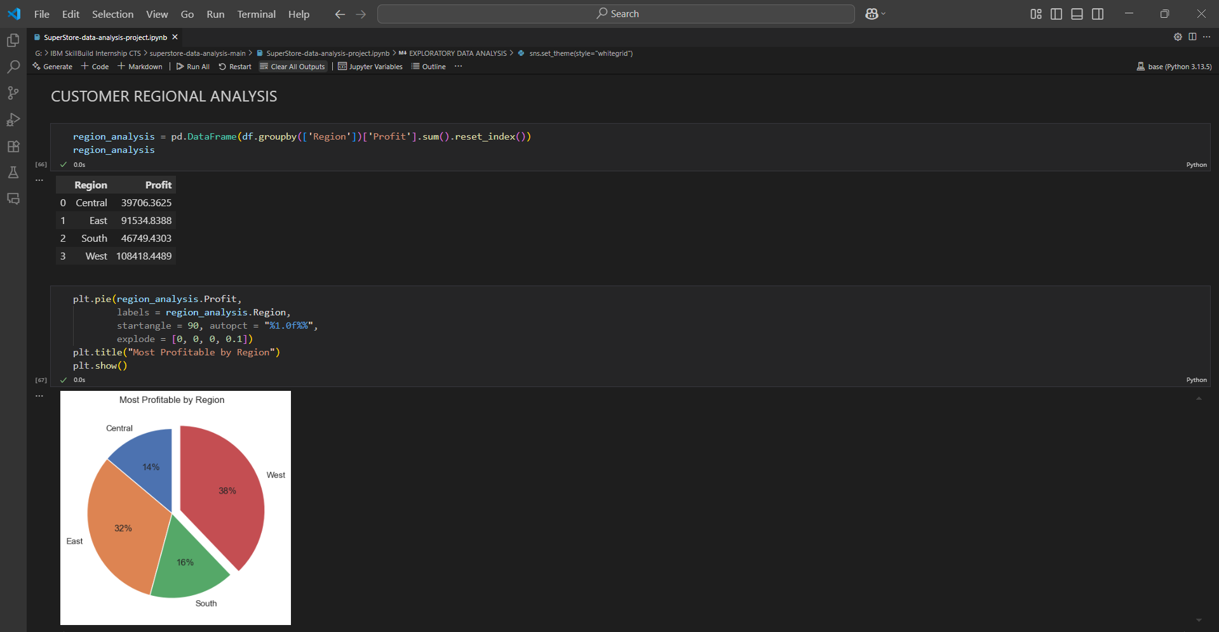
Results and screenshots

Slide 44
Conclusion
The SuperStore data analysis using AI and data science techniques provides deep insights into business performance, customer behavior, and operational bottlenecks. Through exploratory data analysis, machine learning models, and forecasting techniques, we have demonstrated how businesses can leverage data to make informed decisions.
Key takeaways include:
Identification of high-performing product categories and loss-making areas.
Discovery of customer segments through clustering, enabling targeted marketing.
Accurate sales forecasting using time-series models to support inventory and resource planning.
Use of predictive analytics to understand profit drivers and optimize discount strategies.
The integration of AI methods such as machine learning, clustering, and forecasting has shown significant potential to improve efficiency, profitability, and customer satisfaction in a retail environment. Moreover, visual analytics and dashboards make these insights accessible and actionable for business stakeholders.
With the growing accessibility of advanced AI tools, the future holds even more promise. Businesses can further evolve by incorporating real-time analytics, personalized recommendation engines, and geospatial intelligence into their decision-making processes.
In conclusion, data science and AI not only empower SuperStore to understand its present but also to anticipate its future — turning raw data into strategic advantage.

Slide 45
Future scope
As businesses increasingly adopt data-driven strategies, the scope of AI and data science in retail analytics is expanding rapidly. Below are some key future directions and enhancements that can be applied to the SuperStore analysis:
1. Advanced AI for Personalized Recommendations
Objective: Use customer purchase history, behavior, and segmentation data to recommend products.
Methods: Collaborative filtering, content-based filtering, or hybrid recommendation systems (e.g., matrix factorization, deep learning-based recommenders).Impact: Increase cross-selling, upselling, and customer satisfaction.
2. Real-Time Analytics & Streaming Data
Objective: Monitor sales, inventory, and customer behavior in real time.
Tools: Apache Kafka, Spark Streaming, and real-time dashboards using Power BI or Grafana.
Impact: Enables faster business decisions and immediate response to market trends.
3. Integration with ERP and CRM Systems
Objective: Combine SuperStore data with broader enterprise systems for holistic analytics.
Use Case: Unified dashboards for sales, supply chain, customer feedback, and finance.
Impact: Greater operational efficiency and 360° business insight.

Slide 46
Future scope
4. Predictive Inventory and Demand Planning
Objective: Predict future demand per region or product category using AI.
Techniques: Deep learning (LSTM/GRU), Prophet, or AutoML.
Impact: Reduce overstocking or stockouts, optimize warehouse management.
5. Geospatial Analysis
Objective: Analyze location-based sales patterns using maps and GIS data.
Tools: QGIS, Plotly, GeoPandas, Tableau Map Layers.
Impact: Optimize delivery routes, open new stores in high-potential regions.
6. Sentiment Analysis from Customer Reviews
Objective: Extract customer sentiment from feedback or reviews.
Techniques: NLP using BERT, RoBERTa, or LLMs (ChatGPT API for summarization).
Impact: Improve product quality, customer service, and retention.

Slide 47
Future scope
7. AI Chatbots for Sales & Support
Objective: Deploy AI chatbots trained on SuperStore data to guide customers.
Use Case: Automated helpdesk, guided shopping assistants.
Tools: OpenAI, Dialogflow, Rasa.
Impact: Better customer engagement and reduced support costs.
8. Ethical AI & Bias Detection
Objective: Ensure fairness and explainability in AI models (e.g., customer segmentation, credit scoring).
Tools: SHAP, LIME, AI Fairness 360.
Impact: Trustworthy AI systems and regulatory compliance (e.g., GDPR).
9. Augmented Reality (AR) & Visual AI for Retail
Objective: Visual product recommendations and in-store AR experiences.
Techniques: Computer vision, AR SDKs, Visual Search.
Impact: Next-generation retail experience.

Slide 48
References
📖 Books:
"Data Science for Business" by Foster Provost & Tom Fawcett
"Python for Data Analysis" by Wes McKinney
"Hands-On Machine Learning with Scikit-Learn, Keras, and TensorFlow" by Aurélien Géron
📄 Research Papers:
Aggarwal, C. C. (2015). Data Mining: The Textbook – Comprehensive methods in clustering, classification, and forecasting.
Hyndman, R. J., & Athanasopoulos, G. (2018). Forecasting: Principles and Practice – For ARIMA and time series modeling.
Chen, T., & Guestrin, C. (2016). XGBoost: A scalable tree boosting system – Use for boosting models on tabular data.

Slide 49
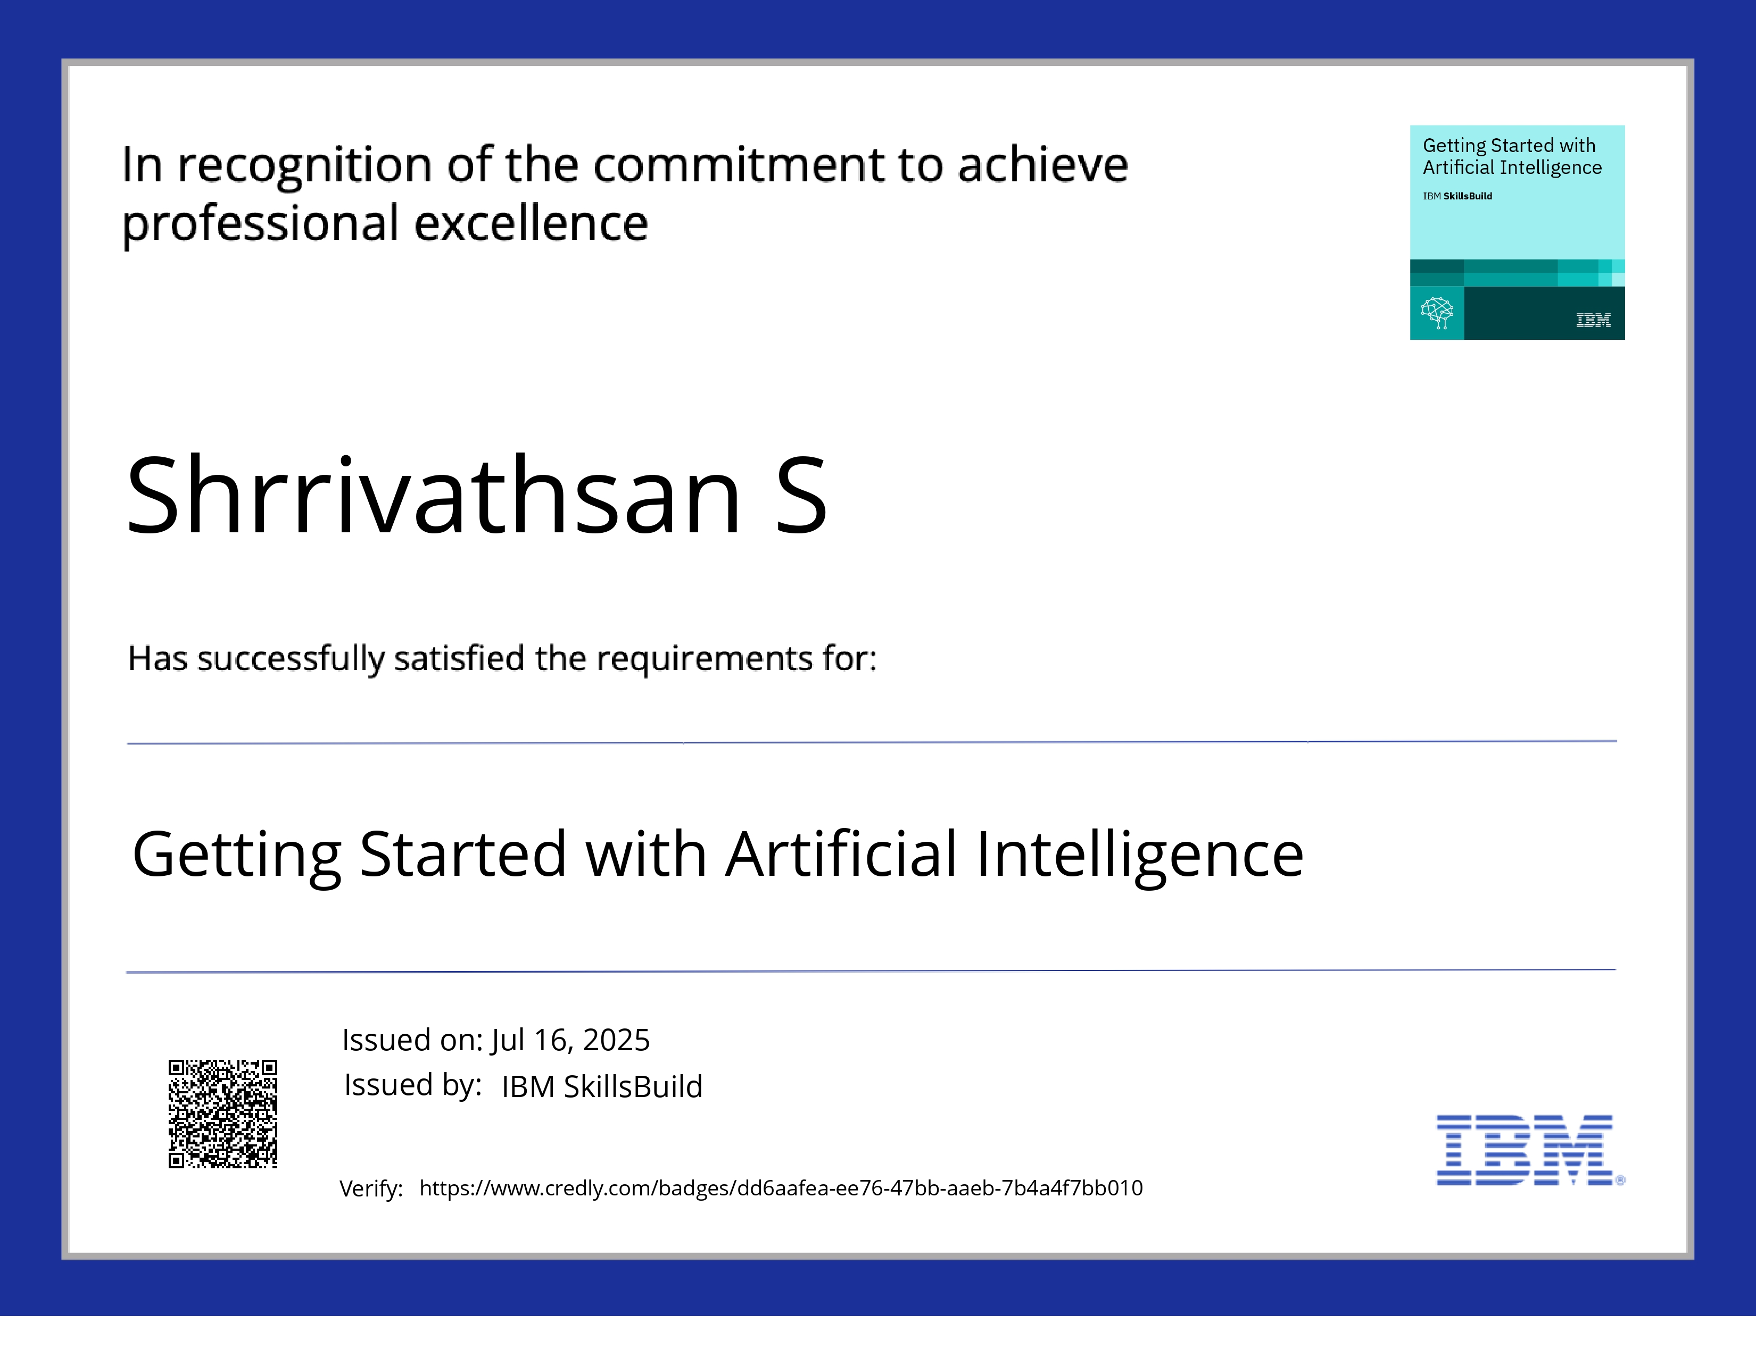
IBM Certifications

Slide 50
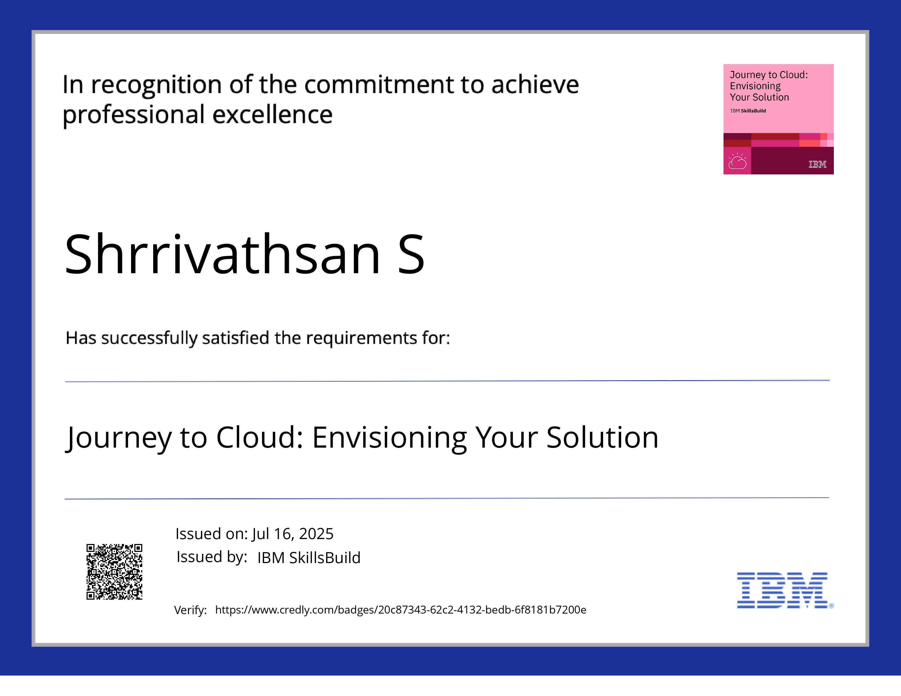
IBM Certifications

Slide 51
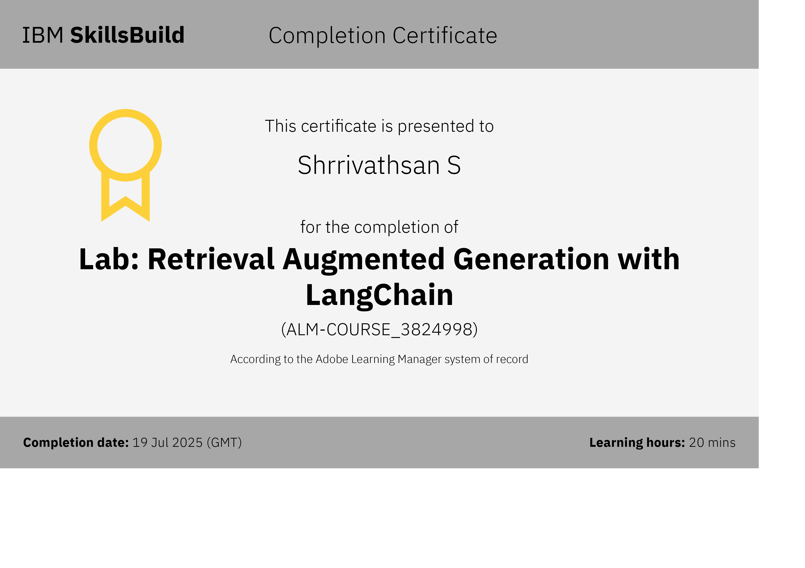
IBM Certifications

Slide 52
THANK YOU

